Slide 1
MATLAB programming
Cell array(異質陣列 )

Slide 2
Contain
Main purpose
  Store (varying data types) in a single matrix
  Access by index
Main issues
  (build-up) cell array
  (display) cell array
  (Access) cell array

Slide 3
(build-up) cell array - Cell Indexing
Method：Define the contains of the cell array by {} & using index
Ex: cell01.M
A(1,1) = {'This is the first cell.'};
A(1,2) = {[5+j*6 , 4+j*5]};
A(2,1) = {[1 2 3; 4 5 6; 7 8 9]};
A(2,2) = {{'Tim'; 'Chris'}}

Slide 4
Cell-Indexing (cont)
Build up 2-Dim cell array A:2*2 with the contains:
A(1,1)：
'This is the first cell'
字串
A(1,2)：
[5+j*6 4+j*5]
1*2複數陣列
A(2,1)：
1 2 3
4 5 6
7 8 9
3*3整數陣列
A(2,2)：
{'Tim', 'Chris'}
2*2異質陣列

Slide 5

(build-up) cell array - Content Indexing
做法：matrix use () for addressing (index) → cell array use {} for addressing Ex: cell02.m
A{1,1} = 'this is the first cell.';
A{1,2} = [5+j*6, 4+j*5];
A{2,1} = [1 2 3; 4 5 6; 7 8 9];
A{2,2} = {'Tim'; 'Chris'}
Same results as previous definition

Slide 6
(build-up) cell array
– use big parantheses {}
Directly use { } to include all elements
Ex:
>> B = {'James Bond', [1 2;3 4;5 6]; pi, magic(5)}
>> C = {rand(3), ones(2); zeros(5), randperm(4)}
B = 'James Bond' [3x2 double]
[ 3.1416] [5x5 double]
C = [3x3 double] [2x2 double]
[5x5 double] [1x4 double]

Slide 7
Merge of cell arrays
Merge of cell arrays by using [ ]
examples (B,C as before) ：
>> M = [B C] % merge [ B C ] by left-right arrangement
M =
'James Bond‘ [3x2 double] [3x3 double] [2x2 double]
[ 3.1416] [5x5 double] [5x5 double] [1x4 double]

Slide 8
Display cell array
Matlab usually display the data types of the cell array instead of its values
範例：
>> A
A =
'this is the first cell.' [1x2 double]
[3x3 double] {2x1 cell }

Slide 9
Cellplot graph-type
cellplot -- display the datatype of the cell array
Ex:cell03.m
A{1,1} = 'this is the first cell.';
A{1,2} = [5+j*6, 4+j*5];
A{2,1} = [1 2 3; 4 5 6; 7 8 9];
A{2,2} = {'Tim'; 'Chris'};
cellplot(A) % 以圖形的方式顯示異質陣列 A 的內部資料型態

Slide 10
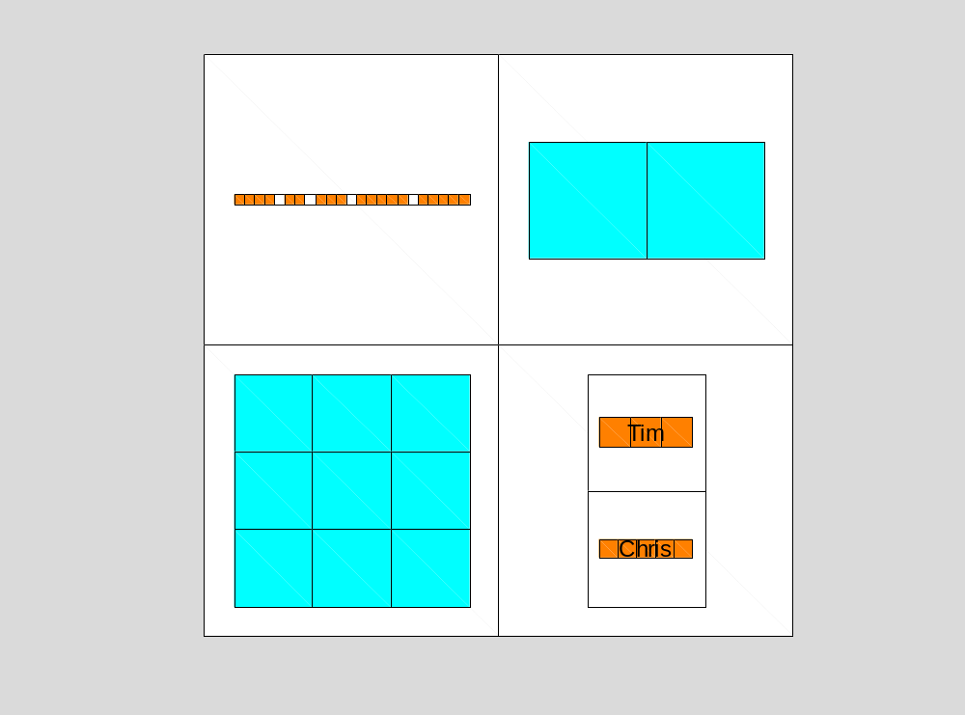
Result

Slide 11
celldisp
Ex:
>> celldisp(A) % display the values of the cell elements
A{1,1} =
this is the first cell.
A{2,1} =
1 2 3
4 5 6
7 8 9
A{1,2} =
5.0000 + 6.0000i 4.0000 + 5.0000i
A{2,2}{1} =
Tim
A{2,2}{2} =
Chris

Slide 12

Content Indexing
Content Indexing，
methods:
  Show the contents of the cell array A, or display the contents of the element by using indexing & {}
  >> A{:}
  >> A{1,2}

Slide 13
Result
ans =
this is the first cell.
ans =
1 2 3
4 5 6
7 8 9
ans =
5.0000 + 6.0000i 4.0000 + 5.0000
ans =
‘Tim’
‘Chris’

Slide 14

access the contains of the cells
Direct access to cells
Takes the internal contains of the cell
from the outer cell
Access or delete multiple elements at once
Cell can replace comma-separated (;)
variable columns

Slide 15
Directly access of cell (1/2)
The example first creates a cell array B, and then takes the elements in the first row and the second row:
>> B = {'James Bond', [1 2;3 4;5 6]; pi, magic(5)}
B =
'James Bond' [3x2 double]
[ 3.1416] [5x5 double]
Hint: magic(n)

Slide 16
>> F = B{1,2}
% Take the elements of the 1st row and the 2nd row of the cell array B
Result:
F =
1 2
3 4
5 6

Slide 17

If the element is a matrix then first Content Indexing then matrix indexing
Ex:
>> G = B{1,2}(3,1)
G =
5

Slide 18
Access or delete multiple elements
B cell array as before
>> H = B(2,:) % access 2-nd row of B
H =
[3.1416] [5x5 double]
>> B(1,:) = [] % delete first row of B cell array
B =
[3.1416] [5x5 double]

Slide 19

separate by comma ‘ , ‘
Ex: % build up a 1×4 cell array (separate by comma ‘ , ‘
>> F = {[2 3 5], [1 2 3], 'Timmy', 'Annie'};
>> F{1:2}
ans =
2 3 5
ans =
1 2 3

Slide 20
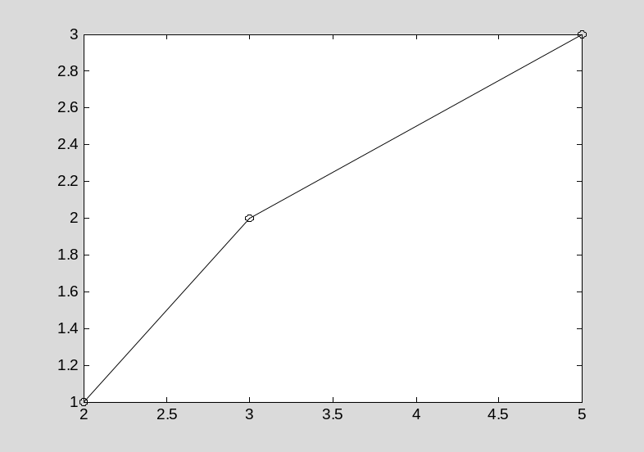
As previous, F{1:2} with contents「[2 3 5], [1 2 3]」
Use cell as the input variables ，Example：
>> plot(F{1:2}, '-o')
Result:

Slide 21
Also, cell array can be used as the output variables
Ex:
>> [F{1:2}] = max(rand(5))
F =
[1x5 double] [1x5 double]
%F為一1x2的異質陣列

Slide 22
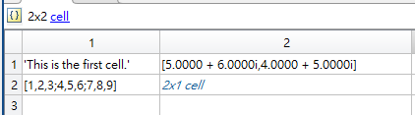
Exercise 1
Get the array element A(2,2)
Get the value of the array element to another cell array : C
Display the cell array
Change the values of the cell array
Build up an empty 3*2 cell array : D
Put the cell array A to part of D.

Slide 23
Other related instructions
Change the shape of the cell array
（Pre-Allocate) zero cell array
Check whether it is a cell array or not
Transfer number array to cell array
Transfer (Structure) in all field to cell array
Transfer cell array to (Structure)
Transfer (Structure) in certain field to cell array
將一結構陣列的某一欄位值轉換成異質陣列

Slide 24
Change the shape of the cell array
「reshape」
Ex: B為2x2異質陣列
B =
'James Bond‘ [3x2 double]
[ 3.1416] [5x5 double]
Result:
>> M = B(:)
M =
'James Bond'
[ 3.1416]
[3x2 double]
[5x5 double]
>> N = reshape(B,1,4)
N =
'James Bond' [3.1416] [3x2 double] [5x5 double]

Slide 25
（Pre-Allocate) zero cell array
Use cell
Ex:
>> E = cell(4, 3)
% （Pre-Allocate) zero 4*3 cell array
Result:
E =
[] [] []
[] [] []
[] [] []
[] [] []

Slide 26
Check whether it is a cell array or not
iscell Ex:iscell01.m
C = {[1,2,3]; 'This is a test.'};
iscell(C)
ans =
1
Hint: here，iscell is ture return 1，if not reture 0。

Slide 27
transfer numeric array to cell array(1/5)
num2cell : transfer numeric array to cell array ：
  C = num2cell(A, dim)
dim : means didn’t change the dimension，other it will assign to the contents to a 1×1 cell array

Slide 28
Ex:num2cell01.m
A = [1 2 3;4 5 6]; % 建立一個數值陣列 A
C = num2cell(A) % 將數值陣列 A 轉成異質陣列 C
C =
[1] [2] [3]
[4] [5] [6]

Slide 29
transfer each column of numeric array A to cell array D
Ex:：num2cell02.m
A = [1 2 3;4 5 6]; % 建立的一個數值陣列 A
D = num2cell(A, 1) % 1 代表「橫列被切割」
D =
[2x1 double] [2x1 double] [2x1 double]

Slide 30
transfer each row of numeric array A to cell array D
Ex:num2cell03.m
A = [1 2 3;4 5 6]; % 建立的一個數值陣列 A
E = num2cell(A, 2) % 2 代表「直行被切割」
E =
[1x3 double]
[1x3 double]

Slide 31
將數值陣列轉換成異質陣列 (5/5)
若需要更複雜的轉換，可以使用mat2cell指令
Ex:
X = [1 2 3 4; 5 6 7 8; 9 10 11 12]
C = mat2cell(X,[1 2],[1 3])
X =
1 2 3 4
5 6 7 8
9 10 11 12
C =
[ 1] [1x3 double]
[2x1 double] [2x3 double]

Slide 32


Convert Cell Array to Numeric Array
Convert numeric arrays in four cells of a cell array into one numeric array.
C = {[1], [2 3 4];
[5; 9], [6 7 8; 10 11 12]}
A = cell2mat(C)

Slide 33
struct2cell transfer structure to cell 。
Ex:struct2cell01.m
student.name = 'Tim';
student.age = 8; %student為一struct
sCell = struct2cell(student)
sCell =
'Tim'
[ 8]
cell2struct in the
next chapter

Slide 34
Transfer one field of the struct to a cell
deal 指令
Ex:deal01.m
S = struct('name',{'Tim','Annie'},'age', {8,5});
[sCell{1:length(S)}] = deal(S.name)
sCell =
'Tim '
'Annie'

Slide 35
deal 指令
deal 指令的輸入及輸出引數需有相同個數
如上例中，sCell{1:length(S)} 的作用即是產生以逗點分開的輸出變數列。
善用 deal 指令，可達成事半功倍之效，
以下欲列出 MATLAB 根目錄下所有目錄（不含檔案）

Slide 36
本章指令彙整
指令
功能
cellplot(A)
以圖形的方式顯示異質陣列 A 的內部資料型態
celldisp(A)
顯示異質陣列 A 各個構成元素的實際內容
reshape(A,m,n)
改變異質陣列 A 的維度成 m×n
cell(m,n)
預先配置一個維度為 m×n 的空矩陣
iscell(A)
測試變數 A 是否為異質陣列：
傳回值 0，代表不是異質陣列
傳回值 1，代表是異質陣列
num2cell(A, d)
將數值陣列 A 轉成異質陣列，d 表示被切割的維度
struct2cell(A)
將結構陣列 A 的所有欄位名稱值，轉換成異質陣列

